Slide 1

Green Pace
Security Policy Presentation
Developer: Marcus Spruill

Slide 2

OVERVIEW: DEFENSE IN DEPTH

Slide 3
THREATS MATRIX
 |  | Priority
 |  | Low | Medium | High
Likelihood | Likely |  | INT-033-C DCL-057-CPP | STR-051-CPP FIO-030-C MEM-051-CPP
 | Probable | ERR-050-CPP
 | Unlikely | DCL-051-CPP MSC-011-C INT-050-CPP | STR-053-CPP

Slide 4
10 PRINCIPLES
Principles | Coding Standards
Validate Input Data | INT-033-C, INT-050-CPP
Heed Compiler Warnings | DCL-051-CPP, STR-051-CPP, MEM-051-CPP, STR-053-CPP
Architecture and Design for Security
Keep It Simple
Default Deny
Adhere to the Principle of Least Privilege
Sanitize Data Sent to Other Systems | FIO-030-C
Practice Defense in Depth
Use Effective Quality Assurance Techniques | MSC-011-C
Adopt a Secure Coding Standard | ERR-050-CPP, DCL-057-CPP

Slide 5
CODING STANDARDS
Rank | Rule | Severity | Likelihood | Priority | Coding Standard
1 | STR51-CPP | High | Likely | P18 | String Correctness
2 | MEM51-CPP | High | Likely | P18 | Memory Protection
3 | FIO30-C | High | Likely | P18 | SQL Injection
4 | STR53-CPP | High | Unlikely | P6 | String Correctness
5 | INT50-CPP | Medium | Unlikely | P4 | Data Value
6 | INT33-C | Low | Likely | P6 | Data Value
7 | DCL57-CPP | Low | Likely | P6 | Data Type
8 | ERR50-CPP | Low | Probable | P4 | Exceptions
9 | MSC11-C | Low | Unlikely | P1 | Assertions
10 | DCL51-CPP | Low | Unlikely | P3 | Data Type
Ranking evaluated from the Severity, Likelihood and Priority for resolution.

Slide 6
ENCRYPTION POLICIES
Encryption uses a key to reversibly conceal data. The three states of data can use encryption to secure data.
Encryption at rest – Safeguards data against file transfers or file modifications.
Commonly used to store user account credentials.
Encryption in flight – Safeguards data against interception or redirection across a network.
Commonly used for user financial and government data.
Encryption in use - Safeguards data from scanning or dumping of memory.
Commonly used for data such as autofill in web browsers.

Slide 7
TRIPLE-A POLICIES
The Triple-A Policies focus on user permissions to secure data.
Authentication - verifies that an accessing user is correct through a unique combination of account credentials.
Authorization - provides permissions to user accounts.
Accounting - records information about user actions.

Slide 8
Unit Testing
Testing is essential for validating programs for intended behavior.
Unit testing is an approach that tests small software units.

Slide 9
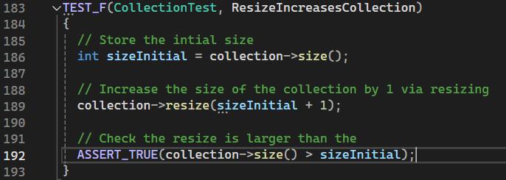
Unit Test - ResizeIncreasesCollection

Slide 10
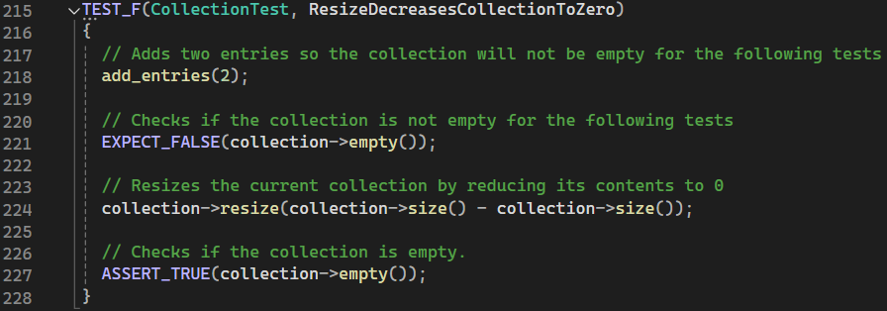
Unit Test - ResizeDecreasesCollectionToZero

Slide 11
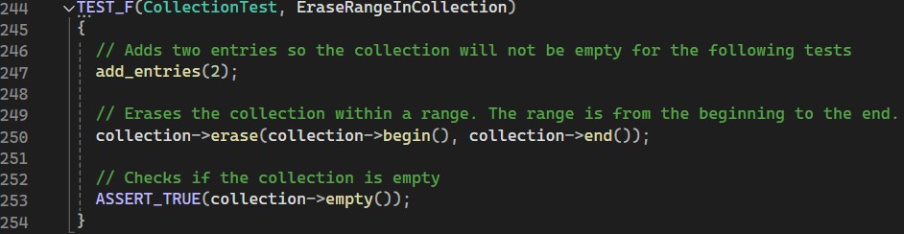
Unit Test – EraseRangeInCollection

Slide 12
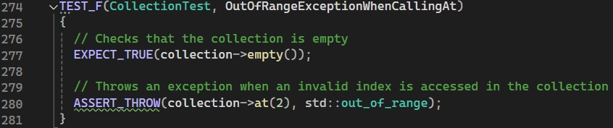
Unit Test – OutOfRangeExceptionWhenCallingAt

Slide 13

AUTOMATION SUMMARY

Slide 14



TOOLS
DevSecOps integrates security into the development and testing process of the software development lifecycle (SDLC).
Automation tools requires significantly less time than a manual review of source code.
Cppcheck
Coverity
SonarLint

Slide 15
RISKS AND BENEFITS
Neglecting software security places sensitive data in jeopardy. Acting early and often gives benefits and avoids risks.
Benefits
Gives more confidence to customers/users.
Avoids fines from regulatory agencies.
Reduces possibility of introducing derivative vulnerabilities.
Risks
Costs increase farther into development.
Possible compensation for sensitive data breaches.
System integrity is threatened.

Slide 16
RECOMMENDATIONS
The current security policy could be improved to provide a more secure environment for data.
More frequent testing
To detect and correct vulnerabilities and unintended behavior
Automated tools
detect and correct issues early with less manual labor
Utilizing encryption
as an additional layer of data protection
Regular audits of the security policy will allow the current process to be updated.

Slide 17
CONCLUSIONS
testing strategies such as unit testing, and automated testing tools should be implemented to detect vulnerabilities.
coding standards are good practice to prevent introducing vulnerabilities.
Defense-in-Depth provides a structure for defending against threats
Implementing the described changes and a proactive approach to implementing new security measures ensures that proper software security can be realized in full.

Slide 18
REFERENCES
Slide 14
Marjamäki, D. (Retrieved August 16, 2024). Cppcheck. Github. https://github.com/danmar/cppcheck
Coverity Scan Static Analysis. (Retrieved August 16, 2024). Synopsis. https://scan.coverity.com/
SonarLint. (Retrieved August 16, 2024). Sonar. https://www.sonarsource.com/products/sonarlint/
Slide 15
Federal Trade Commission. (February, 2024) Equifax Data Breach Settlement. https://www.ftc.gov/enforcement/refunds/equifax-data-breach-settlement

